Slide 1


Design Principles of
Software Development

Slide 2
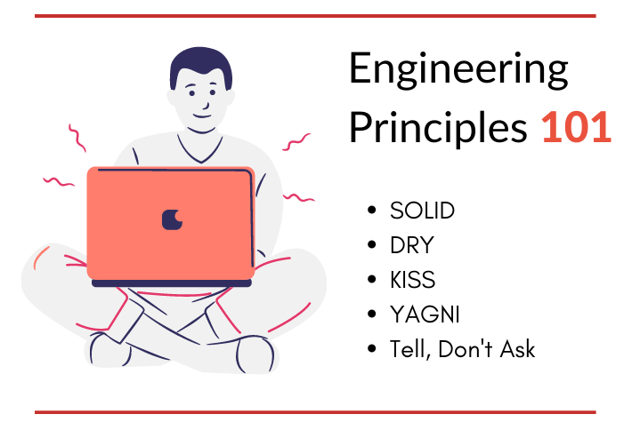
Topics
What are Design Principles?
Design Principles
Yagni Principle
Kiss Principle
Dry Principle
SOLID Principle

Slide 3

What are Design Principles?
Software design principles are a set of guidelines that helps developers to make a good system design. For software design, the goal is to divide the problem into manageable pieces.
Benefits
Easy to understand
Simple
Easy to test
Easy to modify
Easy to maintain
Easy to expand

Slide 4
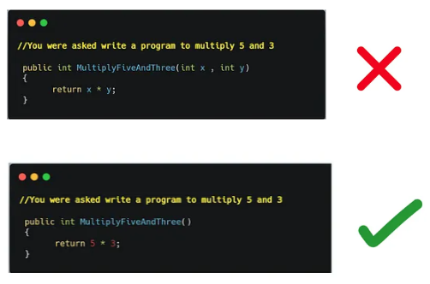

Yagni Principle
Yagni (“You aren’t Gonna Need It” ) principle states that always implement things when you actually need them never implements things before you need them. By implementing
the ideals of programming, you will save
yourself time and be able to move forward
with projects efficiently.
Benefits of using YAGNI
YAGNI principle is to avoid spending time
and money on over engineering things that
you think you will need later on.

Slide 5

Kiss Principle
Kiss (Keep it Short & Simple) principle was coined by Kelly Johnson, and it states that most systems
work best if they are kept simple rather than making them complex; Less code takes less time to write,
has less bugs, and is easier to modify.
Wrong Approach Correct Approach
public String weekday1(int day) public String weekday2(int day)
{ switch(day) { { if ((day < 1) || (day > 7))
case 1: return "Monday"; throw new InvalidOperationException ("day must
case 2: return "Tuesday"; be in range 1 to 7");
case 3: return "Wednesday"; string[] days = { "Monday", "Tuesday", "Wednesday",
case 4: return "Thursday"; "Thursday", "Friday", "Saturday", "Sunday" };
case 5: return "Friday"; return days[day - 1]; }
case 6: return "Saturday";
case 7: return "Sunday";
default: throw new InvalidOperationException("day must be in range 1 to 7"); }}

Slide 6

Kiss Principle
Real life example
A marketer works to find a simple message for promoting toothpaste and comes up with 'For a cleaner, brighter, happier life'.
A politician who wants to reform both tax and local services, uses the message 'You pay less, we do more'.
A consultant writes detailed reports, but always with a straightforward executive summary that gets the key message across

Slide 7

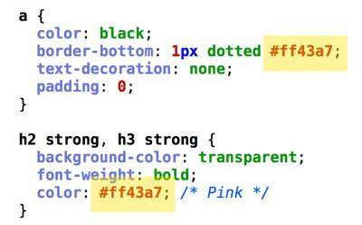
Dry Principle
DRY (Don’t Repeat Yourself) states that each small pieces of knowledge (code) may only occur exactly
once in the entire system. This helps us to write scalable, maintainable and reusable code.
Example
Asp.Net MVC framework
Avoid

Slide 8
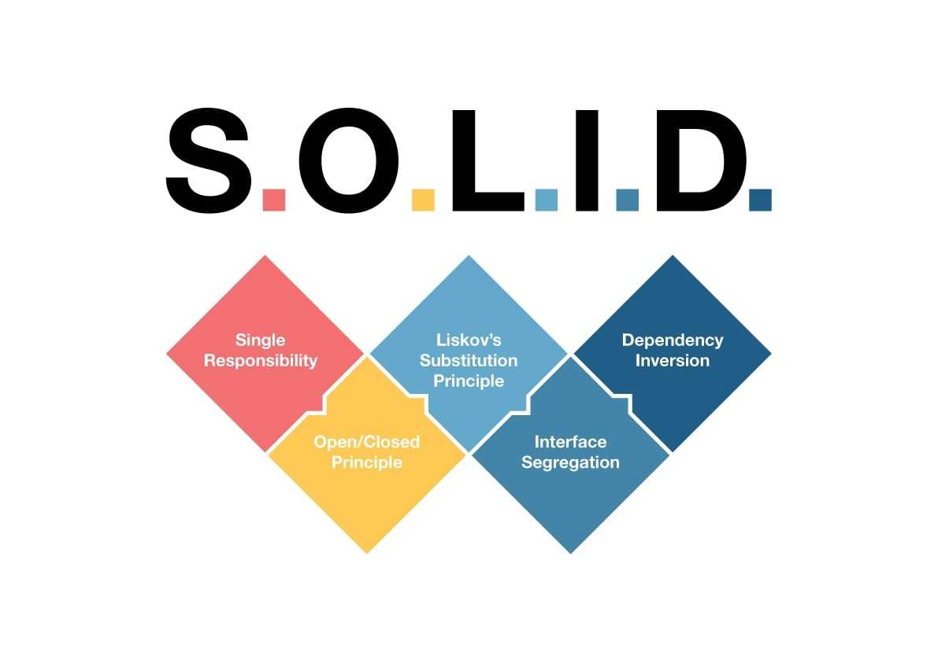
SOLID Principle
It is combination of five basic designing principles
Single Responsibility Principle
Open-Closes Principle
Liskov Substitution Principle
Interface Segregation Principle
Dependency Inversion Principle
In simple terms, the SOLID principles act like UX principles for developers. Have you ever worked on a bug where you had to spend hours reading the code in order to understand what to do? Great developer experience means you can easily navigate through the code and understand.

Slide 9
SOLID Principle
What it does
Ultimately, it results in spending less time figuring out what the code does and more time actually developing the solution.
These five software development principles are guidelines to follow when building software so that it is easier to scale and maintain. They were made popular by a software engineer, Robert C. Martin.
Some of these principles may look similar but they are not targeting the same goal. It is possible to satisfy one principle while violating the other, even though they are alike.
Benefits of SOLID Principles
Write code that’s easy to maintain, read, understand & testable;
Make it easier to extend the system with new functionality without breaking the existing ones;

Slide 10
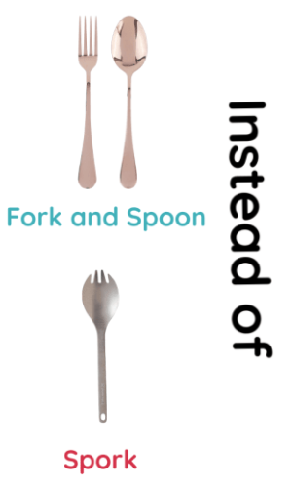
Single Responsibility Principle (SRP)
Single Responsibility Principle states that there should never
be more than one reason for a class to change. This means that
you should design your classes in such a way that each class should
have a single purpose.
Example
An Account class is responsible for managing Current and Saving Account
but a CurrentAccount and a SavingAccount classes would be responsible
for managing current and saving accounts respectively. Hence both are
responsible for single purpose only.

Slide 11
Open-Closes Principle ( (OCP)
Open-Closes Principle states that software entities (classes, modules, functions, etc.) should
be open for extension but closed for modification. The "closed" part of the rule states that once
a module has been developed and tested, the code should only be changed to correct bugs. The
"open" part says that you should be able to extend existing code in order to introduce new
functionality.
Example
A PaymentGateway base class contains all basic payment related properties and methods. This
class can be extended by different PaymentGateway classes for different payment gateway
vendors to achieve theirs functionalities. Hence it is open for extension but closed for
modification.

Slide 12
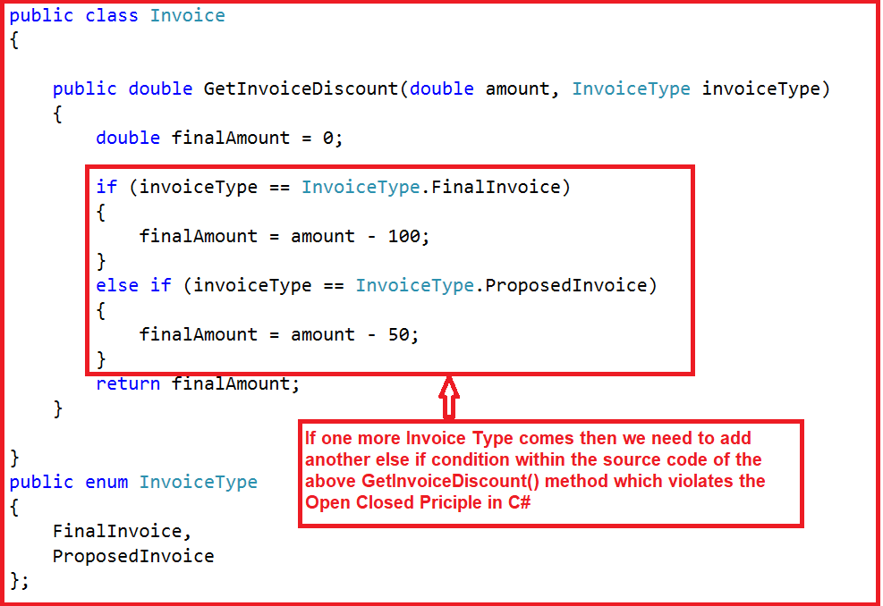
Open-Closes Principle ( (OCP)

Slide 13
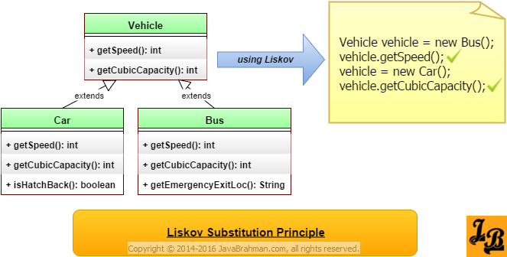
Liskov Substitution Principle (LSP)
Liskov Substitution Principle states that functions that use pointers or references to base
classes must be able to use objects of derived classes without knowing it.
Example

Slide 14
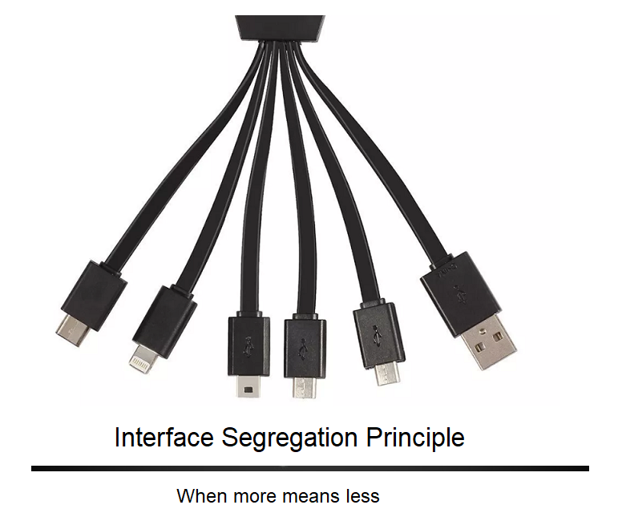
Interface Segregation Principle (ISP)
Interface Segregation Principle states that Clients should
not be forced to depend upon interfaces that they don’t
use. This means the number of members in the interface
that is visible to the dependent class should be minimized.
Example
The service interface that is exposed to the client should
contains only client related methods not all

Slide 15
Interface Segregation Principle (ISP)
An interface representing two different roles. One is the role of handling connections like opening and
closing, and the other is sending and receiving data.
Wrong Approach Correct Approach
public interface Connection { public interface Channel {
void open(); byte[] receive();
void close(); void send(byte[] data); }
byte[] receive(); public interface Connection {
void send(byte[] data); void open();
} void close(); }
A Class should perform only actions that are needed to fulfil
its role. Any other action should be removed completely or moved somewhere
else if it might be used by another Class in the future.

Slide 16
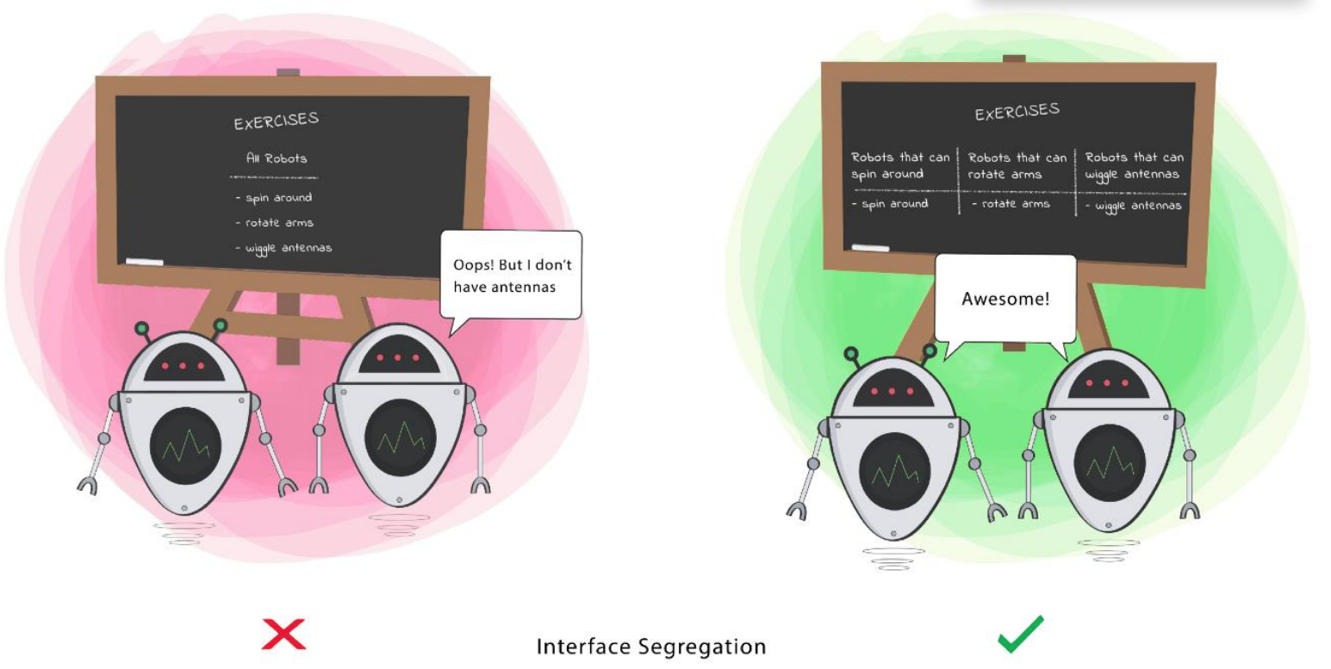

Interface Segregation Principle (ISP)

Slide 17
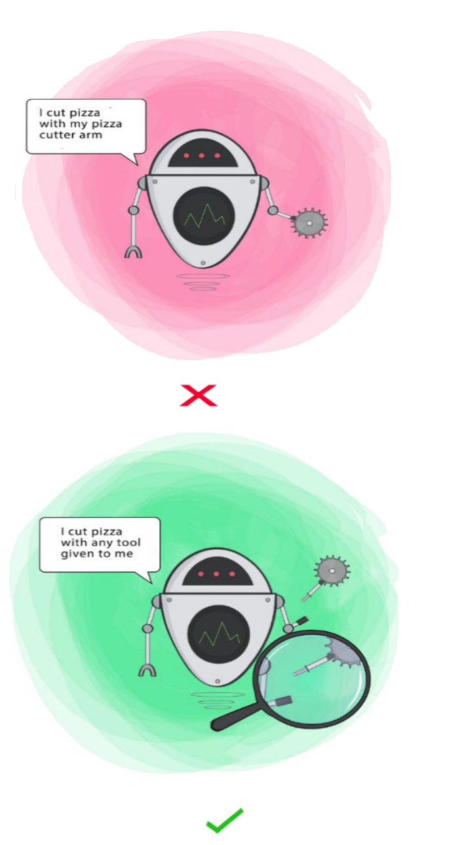
Dependency Inversion Principle (DIP)
Dependency Inversion Principle states that
High level modules should not depend upon low level modules. Both should depend upon abstractions.
Abstractions should not depend upon details. Details should depend upon abstractions.
It helps us to develop loosely couple code by ensuring that high-
level modules depend on abstractions rather than concrete
implementations of lower-level modules. The Dependency
Injection pattern is an implementation of this principle
Example
The Dependency Injection pattern is an implementation of this
principle

Slide 18
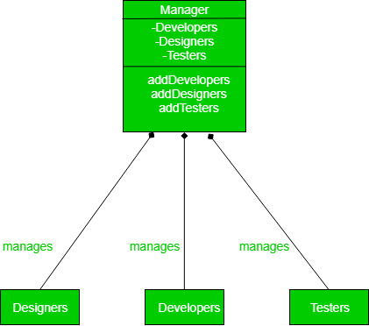
Dependency Inversion Principle (DIP)

Slide 19
Thank you

